Slide 1

Developing a Performance Measurement Framework (PMF)
Based on Global Affairs Canada Results-Based Management Guidance

Slide 2
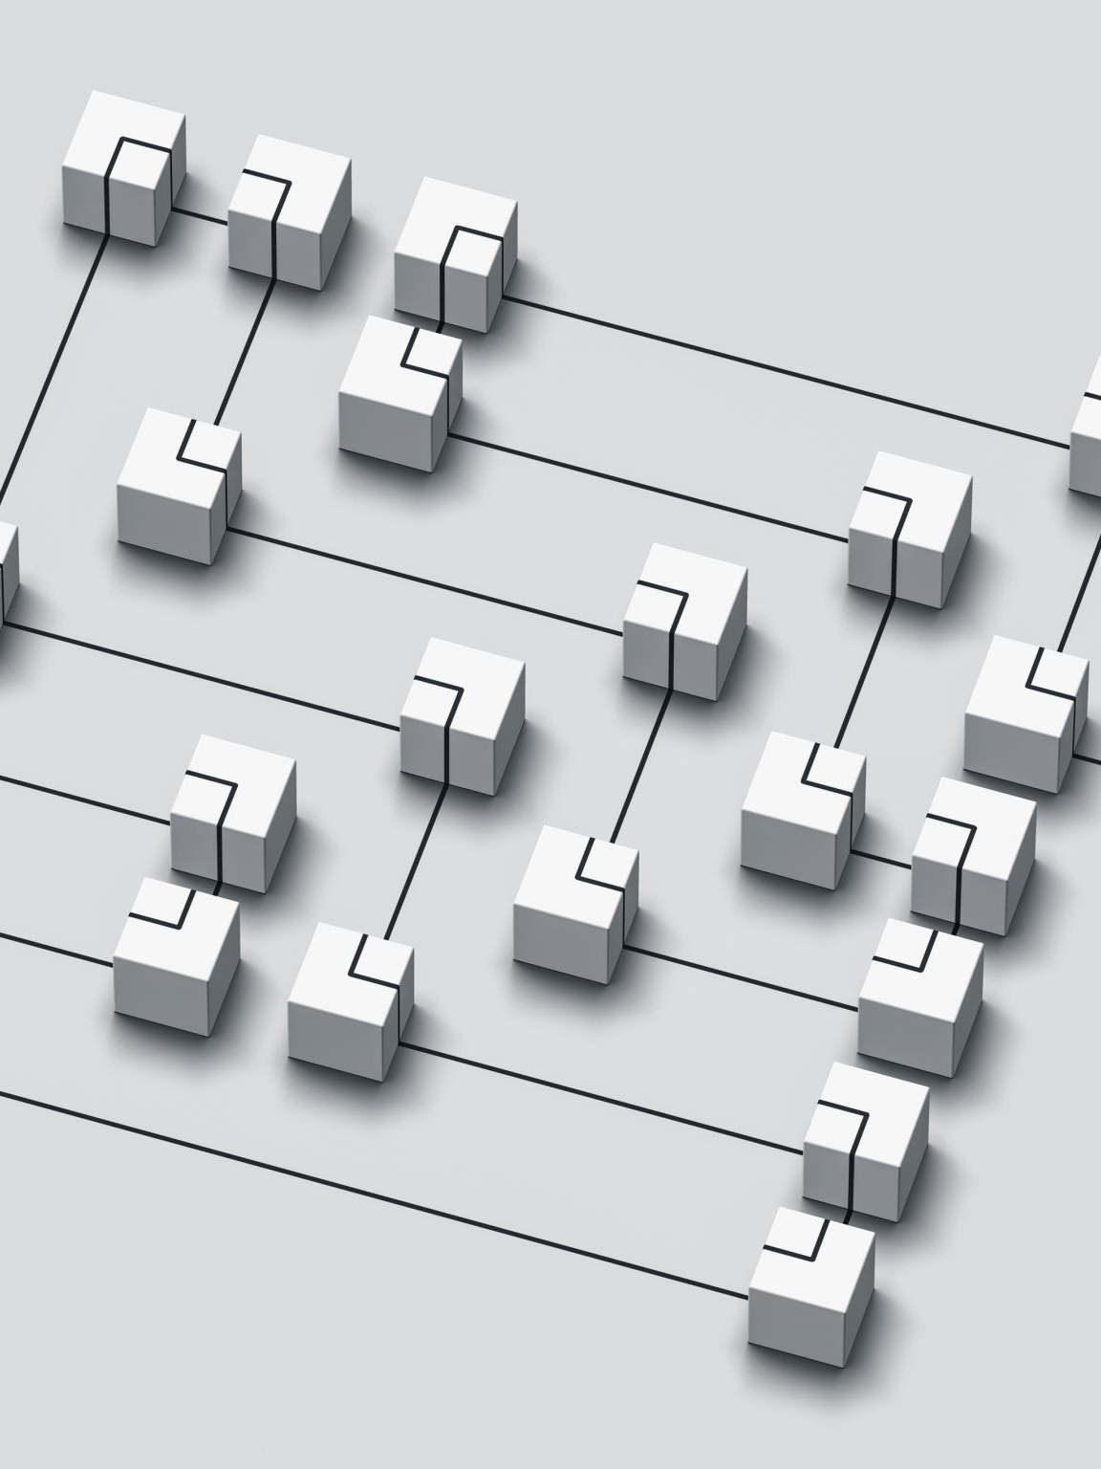
What is a PMF?
• Results-Based Management tool
• Plans systematic data collection
• Tracks progress toward outcomes and outputs
• Foundation of monitoring and evaluation

Slide 3

Why a PMF Matters
• Supports management for results
• Enables evidence-based decision making
• Tracks progress over project life
• Demonstrates accountability

Slide 4

Key Components of a PMF
1. Expected Results
2. Indicators
3. Baseline Data
4. Targets
5. Data Sources
6. Data Collection Methods
7. Frequency
8. Responsibility

Slide 5
Expected Results
• Derived directly from the Logic Model
• Includes outputs and outcomes
• Must remain aligned with the Logic Model

Slide 6
Performance Indicators
• 2–3 indicators per outcome
• 1–2 indicators per output
• Include qualitative and quantitative measures
• Measure gender equality and sustainability where applicable

Slide 7

Baseline Data
• Serves as starting value of an indicator
• Collected before or at the beginning of implementation
• Used as reference point for measuring change
• Must be disaggregated or categorized where relevant

Slide 8
Targets
• Desired future value of an indicator
• Based on baseline data
• End-of-project targets required
• Annual targets recommended

Slide 9
Data Sources
• Primary sources (beneficiaries, stakeholders)
• Secondary sources (surveys, reports, databases)
• Multiple sources improve reliability

Slide 10
Data Collection Methods
• Interviews
• Focus Group Discussions
• Surveys
• Observation
• Record Reviews
• Case Studies and Testimonials

Slide 11
Frequency & Responsibility
• Define how often data is collected
• Specify responsible roles
• Use positions/titles, not individual names

Slide 12
Group Exercise: PMF Template Prototype
Count off from 1 to 5 and form your groups accordingly.
Within your group, co-create and jointly design a prototype template of a standard Performance Measurement Framework (PMF) based on the concepts discussed during the session.
Use a flipchart to develop your PMF, ensuring that it includes the key PMF components:
Prepare a brief presentation highlighting your group's approach and key considerations.
Time Allocation: 10 minutes for group work and preparation, followed by presentations.

Slide 13
Steps in Developing a PMF
1. Copy results from Logic Model
2. Formulate indicators
3. Define sources, methods, frequency, responsibility
4. Enter baseline data
5. Set targets
6. Draft M&E Plan

Slide 14
PMF Quality Checklist
Indicators should be:
• Valid
• Reliable
• Sensitive
• Simple
• Useful
• Affordable
• Gender-responsive

Slide 15
Monitoring and Evaluation Plan
• Develop tools and instruments
• Train data collectors
• Allocate resources
• Plan evaluations and learning activities

Slide 16
Key Presentation Takeaways
• PMF is the backbone of monitoring
• Supports learning and accountability
• Must be participatory and evidence-based
• Essential for project success

Slide 17



THANK YOU FOR LISTENING!!!!!

