Slide 1
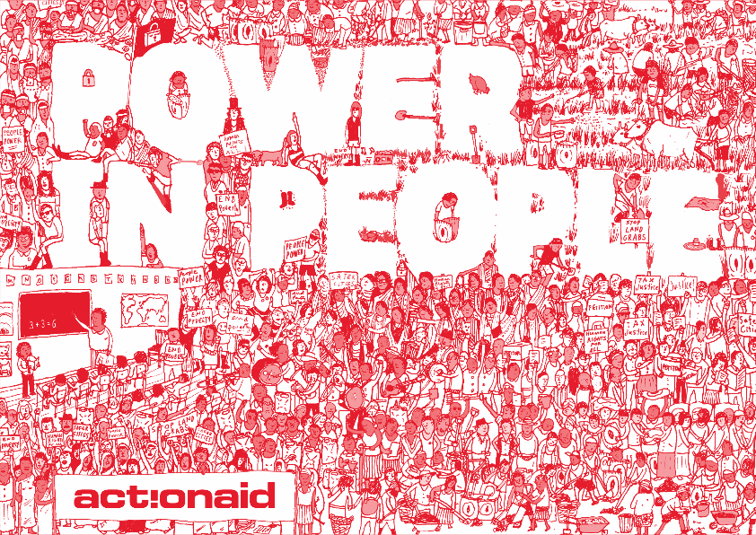
Specific communication objective
Report Writing vs Blog Story
From Formal Writing to Storytelling for Wider Impact

Slide 2
Introduction
Introduction
What is Report Writing?
Report writing is the act of compiling facts, findings, analyses, and recommendations into a structured document that communicates information for decision-making, accountability, or record-keeping.
Report writing is about turning raw information into an organized story that people can understand, trust, and act upon.
Purpose: To document facts, present evidence, and provide accountability.
Tone: Structured, professional, objective.
Audience: Policymakers, donors, technical experts.
Strengths: Credibility, thoroughness, detailed evidence.
Limitations: Often too lengthy, complex, or technical for the general public.

Slide 3
Introduction
Introduction
Why Report Writing Matters
Communication tool: Shares results of work, research, or projects.
Accountability: Documents achievements, challenges, and resource use.
Decision support: Provides insights and recommendations for future action.
Record-keeping: Acts as an official record for reference.
Types of Reports
Research Reports – present study findings.
Project Reports – document implementation, results, and lessons.
Progress Reports – update on ongoing work.
Annual Reports – summarize yearly performance.
Evaluation Reports – assess effectiveness of programmes/projects.
Financial Reports – detail income, expenditure, and budgets.

Slide 4
Definition of a Blog
A blog is a type of online article or web post that shares ideas, experiences, stories, or information in a conversational and engaging style. Blogs are usually shorter and more reader-friendly than formal reports, designed to connect with a wider audience.
Purpose: To connect emotionally and make information relatable.
Tone: Conversational, engaging, simplified.
Audience: General public, media, youth, communities, online readers.
Strengths: Wider reach, easy to share, inspires action, amplifies human voices.
Limitations: Not as detailed or formal as reports.

Slide 5
Why Blogs Matter
Simplify complex information.
Make reports and data relatable.
Reach wider audiences (youth, community members, general public).
Amplify advocacy messages.
Strengthen organisational visibility and thought leadership.

Slide 6
Why Shift from Formal to Storytelling?
Reports inform, but stories inspire.
Reports are read by decision-makers; stories are felt by communities.
Turning a report into a story (via blogs) ensures that data doesn’t stay hidden in documents, but lives in conversations.
Storytelling humanizes statistics, instead of the number of people trained, a blog tells us about the story of an individual farmer whose harvest doubled.”

Slide 7
Example Before & After
Report: In 2023, 40% of women in rural communities lacked access to clean water…
Blog: Imagine waking up every day knowing the water you drink could harm your health. For 4 in 10 women in rural Nigeria, this is a daily reality…
Reports tell us what happened. Blogs tell us why it matters and who it impacts.

Slide 8
The Wider Impact
Accessibility: Blogs make technical information easy for anyone to understand.
Engagement: Stories invite readers to share, comment, and discuss.
Advocacy: A well-written blog can travel further than a PDF report and catch the attention of media, influencers, and policymakers.
Change-making: When people relate to a story, they are more likely to act on it.
NOTE: We don’t abandon formal writing, we transform it. Reports remain important for accountability, but by turning their insights into stories (blogs), we multiply their impact and ensure they reach the hearts and minds of more people.

Slide 9
How to Turn Reports into Blogs
1️⃣ Know Your Audience – Who are you writing for? Tailor tone and style to readers
2️⃣ Extract Key Insights – pull out findings and human stories
3️⃣ Simplify the Language – avoid jargon, use conversational words
4️⃣ Create a Hook – start with a story, stat, or question
5️⃣ Restructure the Content – intro, body, conclusion, call-to-action
6️⃣ Make It Visual – photos, infographics, quotes
7️⃣ Add a Call to Action – inspire readers to share or act

Slide 10
Golden Rules for Turning Reports into Blogs
1️⃣ Not everything in a report belongs in a blog – choose 1–2 strong angles
2️⃣ Blogs should be short & skimmable – 500–1000 words
3️⃣ Tell human-centered stories – focus on people, not just numbers
4️⃣ Use a conversational tone – explain as if to a smart friend
5️⃣ Respect ethics & sensitivity – consented photos, anonymize names
6️⃣ Optimize for online readers – catchy headline, keywords, visuals
7️⃣ End with action or reflection – leave readers thinking or acting

Slide 11
Group Rewrite Exercise
Divide ourselves into 3 groups and rewrite the below report except
Report Excerpt:
“In 2024, ActionAid Nigeria through her Agroecology programme trained 500 women farmers across three states on climate-smart agriculture techniques. The training improved crop yields by 30%, improved economic activities and increased household incomes in participating communities. ”
Task: Rewrite this into a short blog intro as a group.

Slide 12


