Slide 1
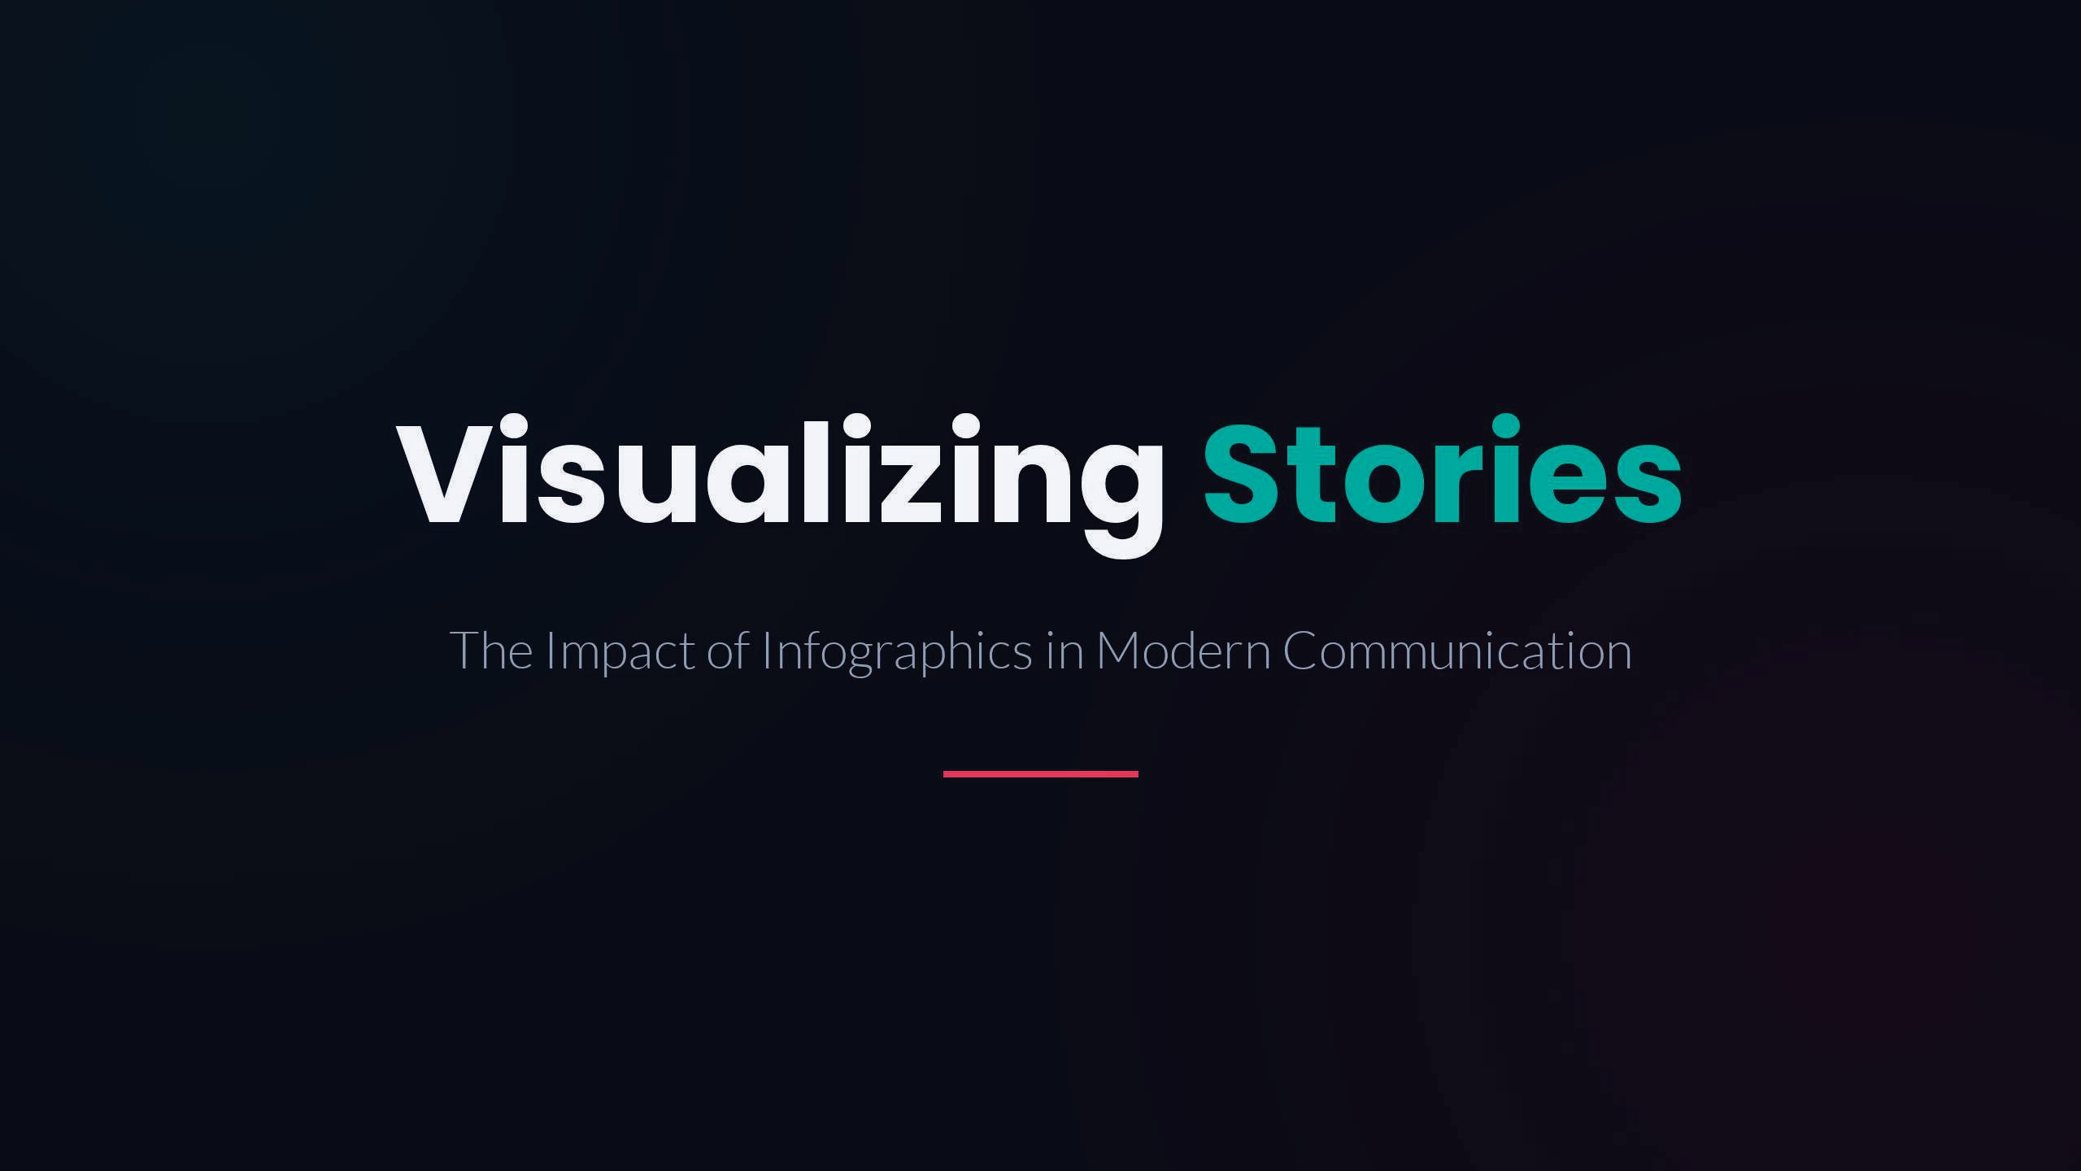
THE IMPACT OF GRAPHICS DESIGN
VICTORY IDOGHO

Slide 2
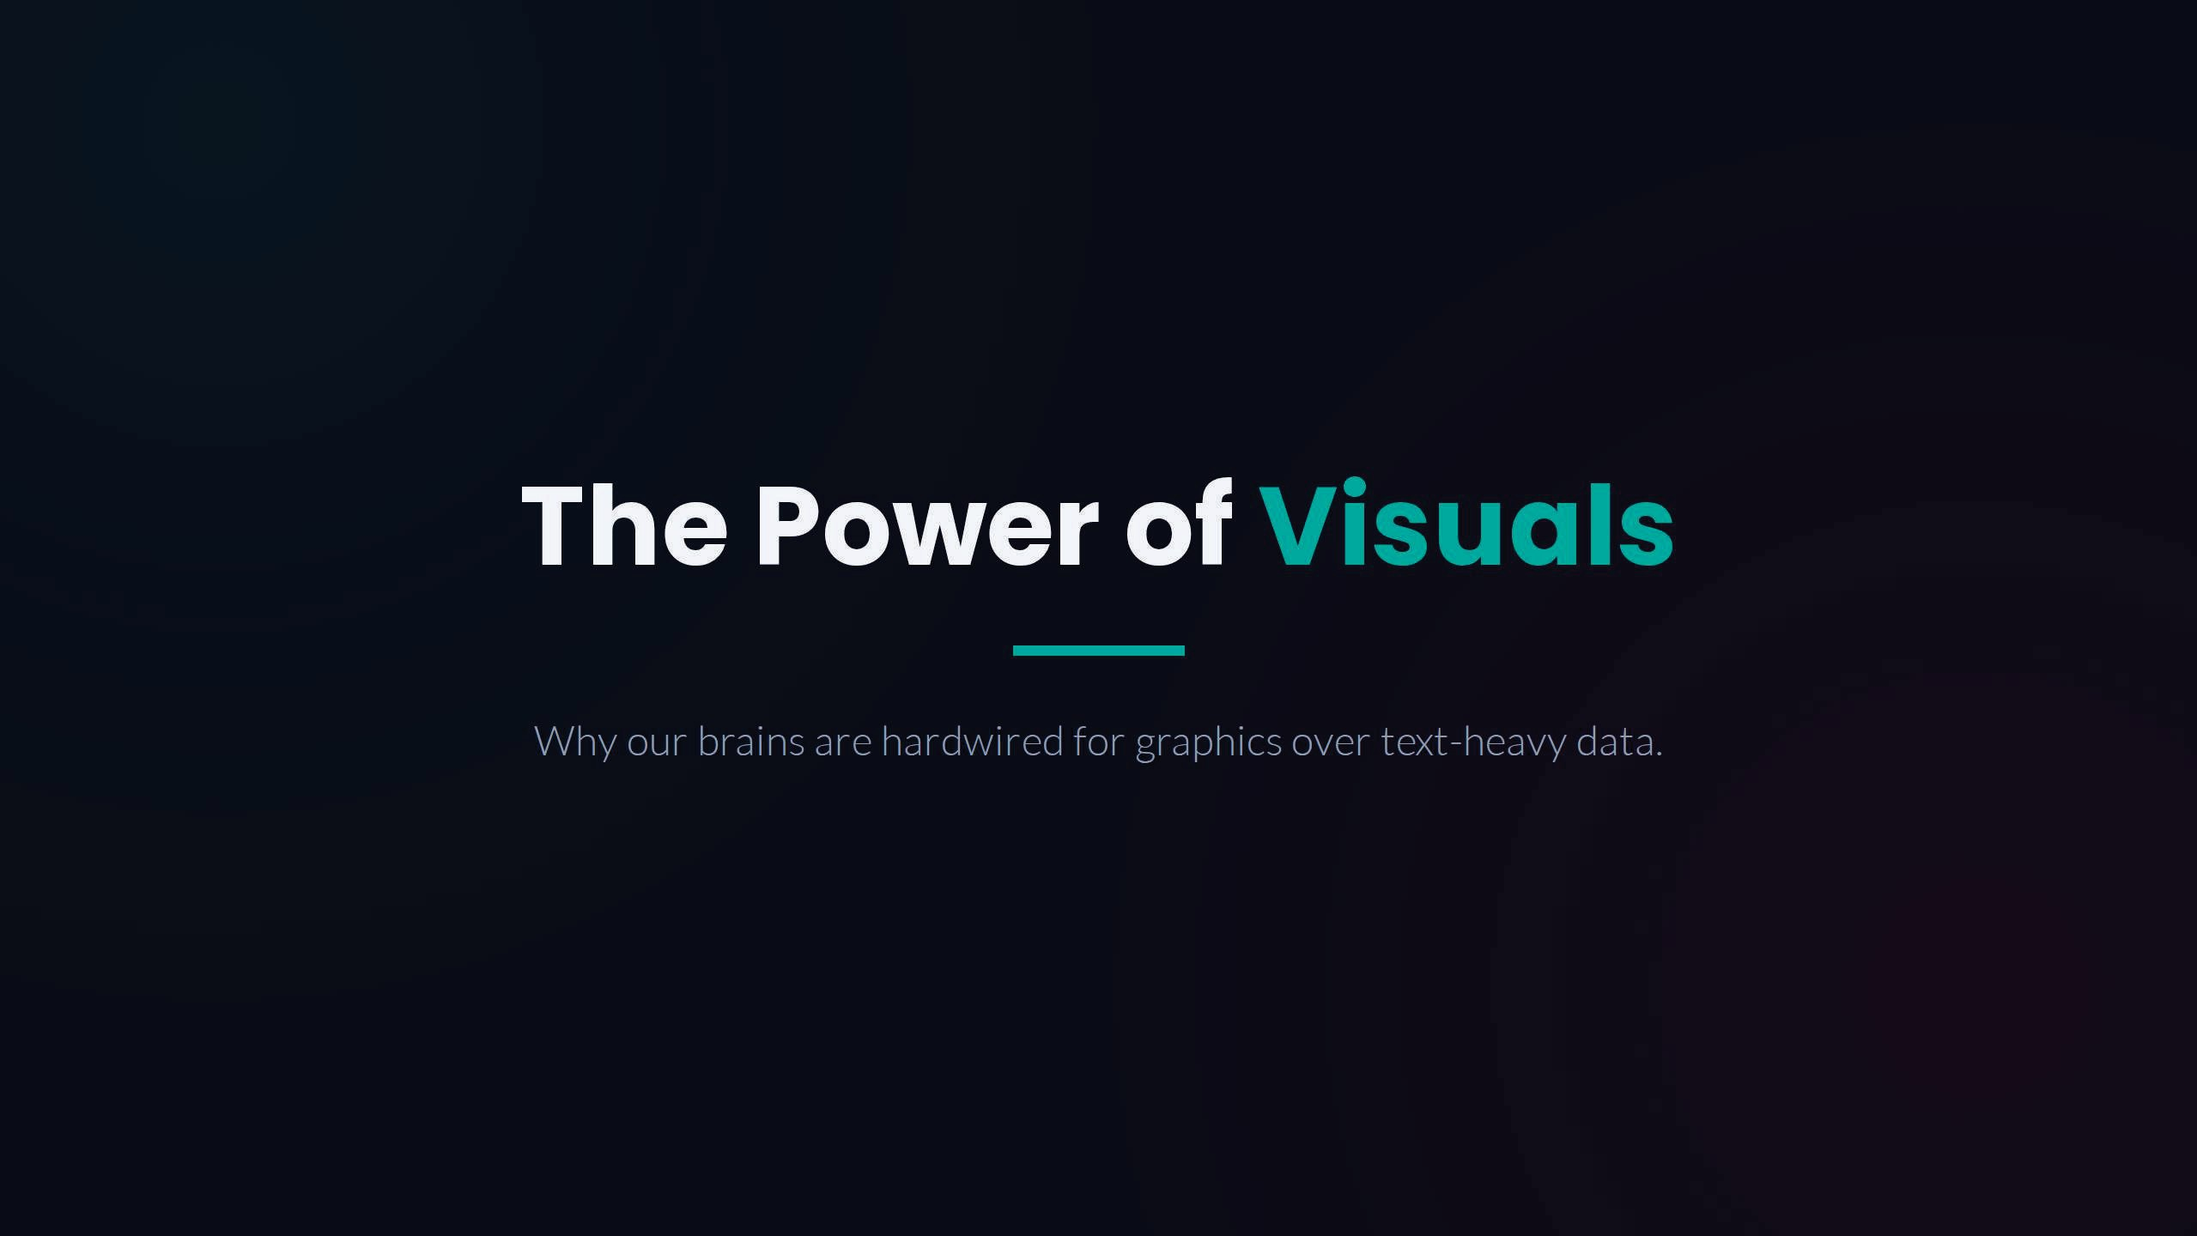
Our brains are hardwired for graphics over text-heavy data because visuals are processed faster, easier to remember, and simplify complex information more effectively than words alone.

Slide 3
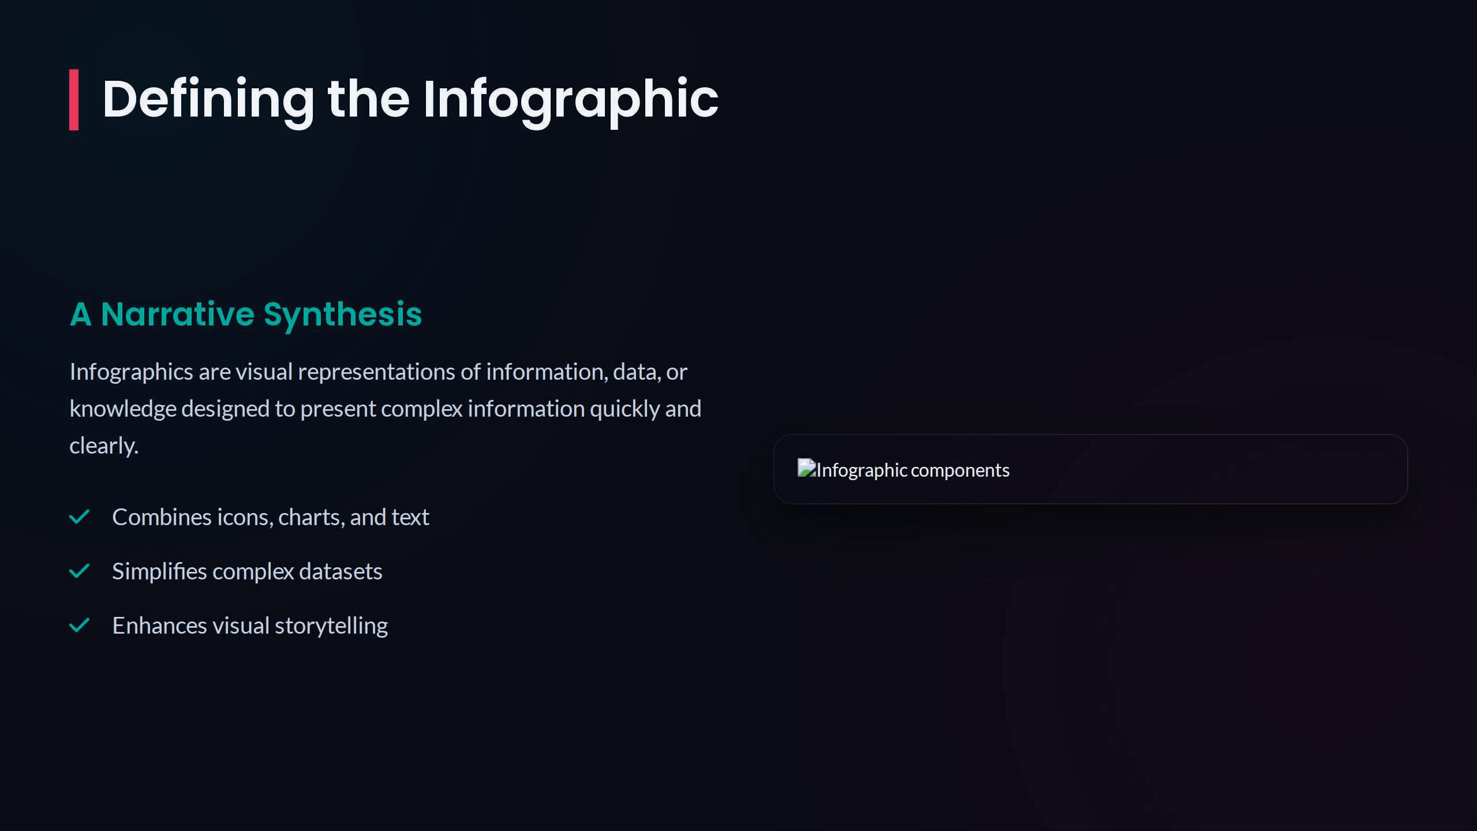

Defining Graphics Design
Graphic Design is the art and practice of creating visual content to communicate ideas, messages, or information effectively through the use of text, images, colors, and layouts.

Slide 4
Why Graphics Matter

Slide 7
Anatomy of Effective Design
Clear Headlines: Hooks the reader and sets the context
immediately.
Consistent Color: Uses visual hierarchy to guide the
viewer's journey.
Logical Flow: Connects data points through a structured
Avoid clutter. "White space" is a vital element that lets
narrative path.
your information breathe and improves scannability.
Data Accuracy: Ensures credibility through verified and cited statistics.

Slide 8
The Impact on Memory
Studies from 3M and the University of Minnesota show that people remember ó.5x more information when paired with relevant visuals than when relying on text alone.
Retention Rate
Retention for text-only after 3 days.

Slide 9
Navigating Common Challenges
Cramming too much data into one graphic can
Misleading scales, clashing colors, or generic icons can
overwhelm the viewer and obscure the core narrative.
damage credibility and misrepresent the underlying
Focus on 3-5 key points.
facts.

Slide 10
Market Adoption Trends

Slide 11
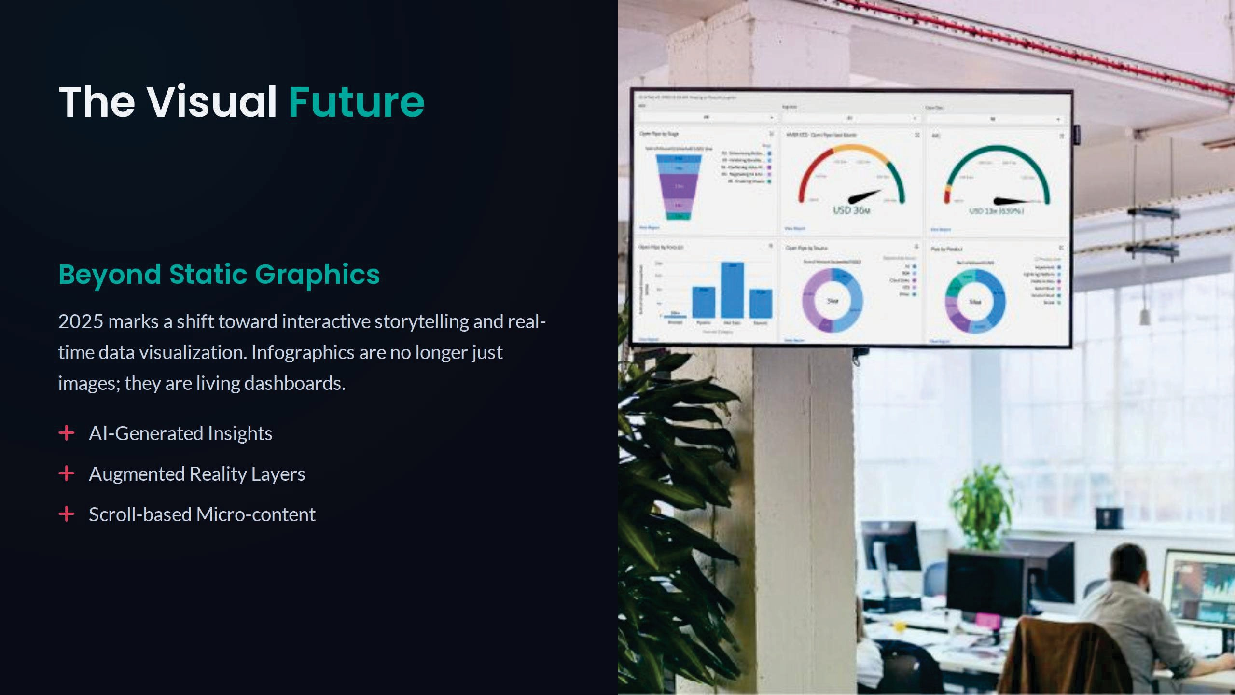

Slide 12
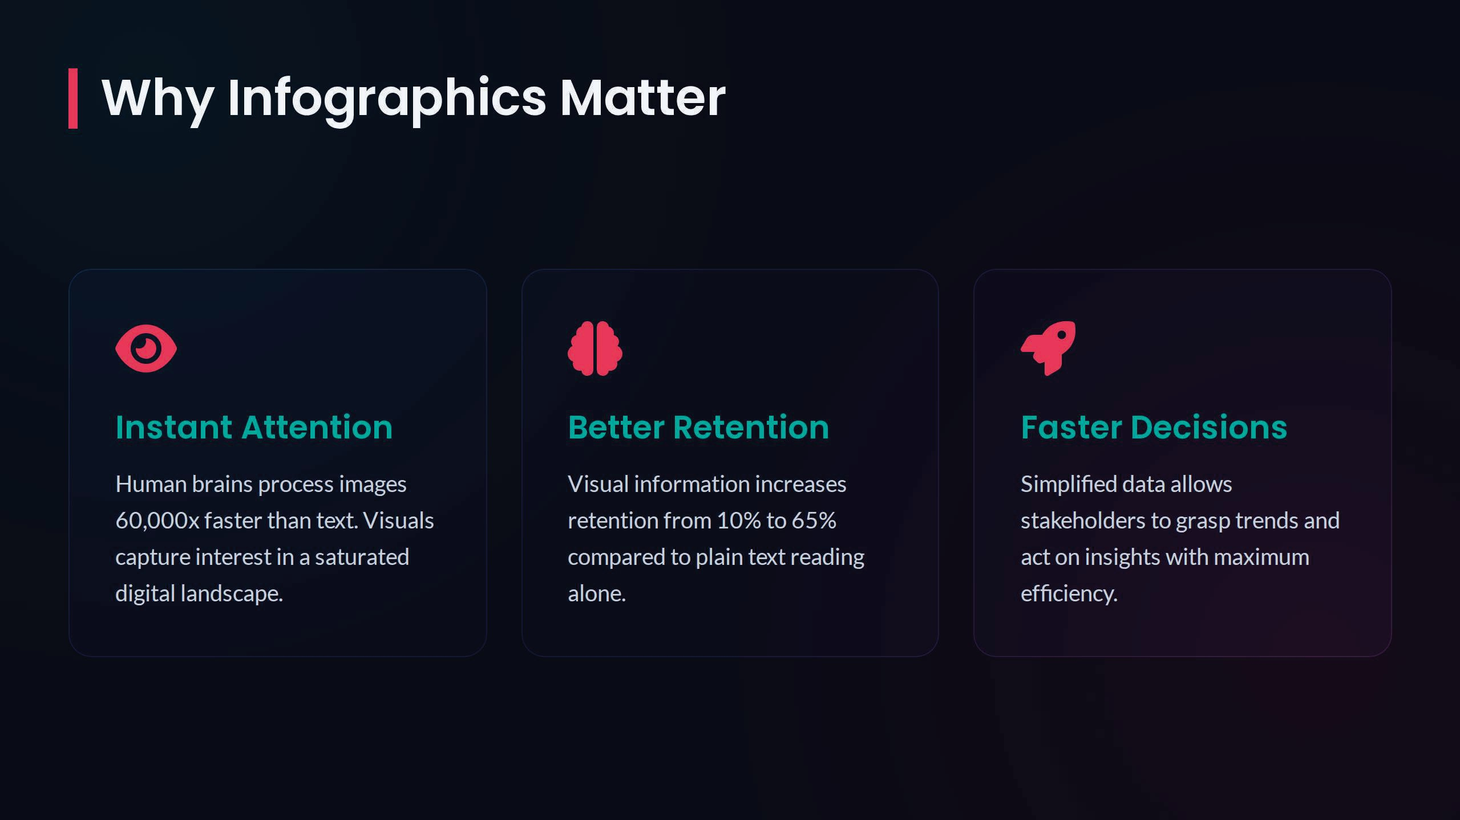
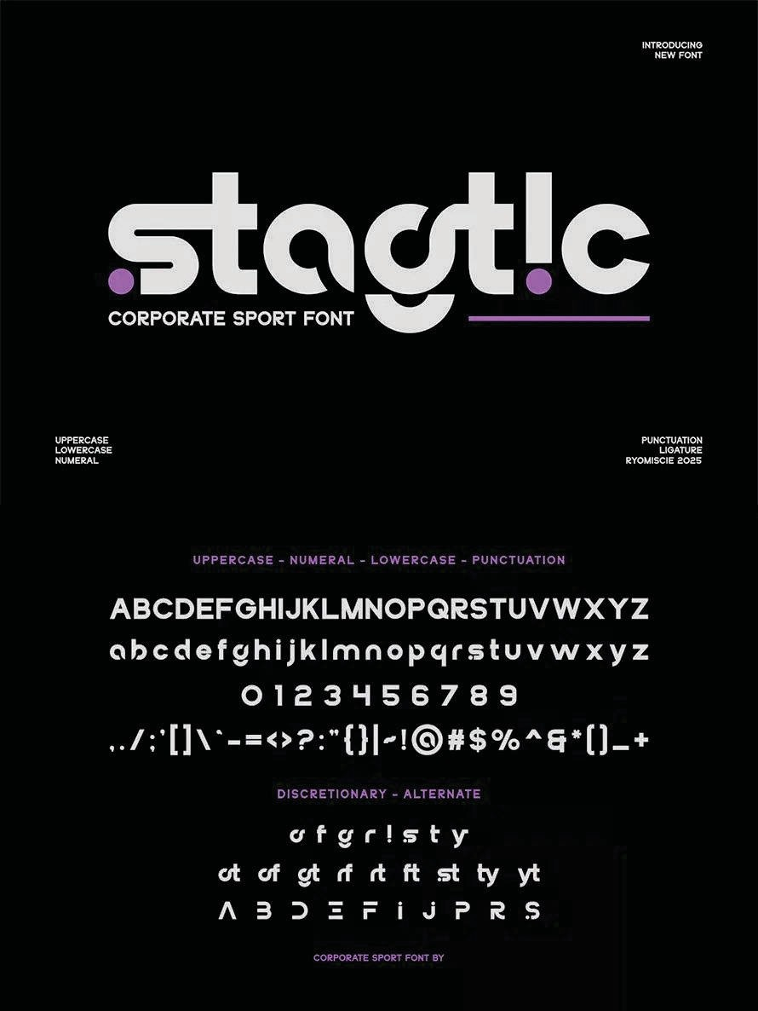
Typography as a Voice
Type Selection
Selecting fonts serves as the vocal tone of your written message. Editorial serifs speak of historical prestige, whereas wide sans-serifs convey modern, forward-looking engineering.
Visual Hierarchy
Guiding structural contrast through weight, scale, and spatial margins creates a clear, predictable scanning framework. This allows readers to effortlessly digest core highlights first.
Custom Lettering
Distinctive, custom typographic elements act as visual anchors. They give a narrative a highly unique signature that sets it entirely apart from competitive noise

Slide 13

The Psychology of Color
Color acts as the emotional soundtrack of your visual narrative. It establishes tone, shifts tempo, and triggers subconscious neurological associations immediately:
Immediate Mood Setting: Bold warm reds spark visceral excitement and urgency, while deep natural greens prompt comfort and deep security.
Attention Navigation: Strategic shifts in color saturation act as structural signposts, effortlessly guiding eye traffic to focal targets.
Cultural Context: Aligning palette choice with cultural parameters establishes instant narrative trust.

Slide 14
Design Layout
Portrait
Landcape
Custom

Slide 15
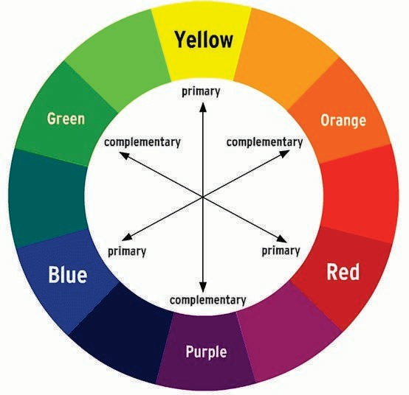
Colour Wheel

Slide 16
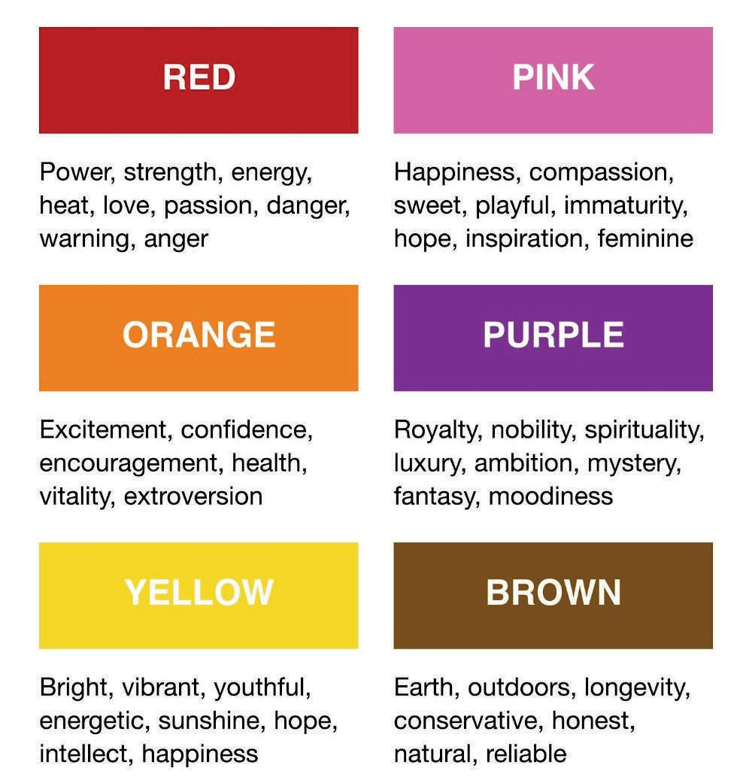
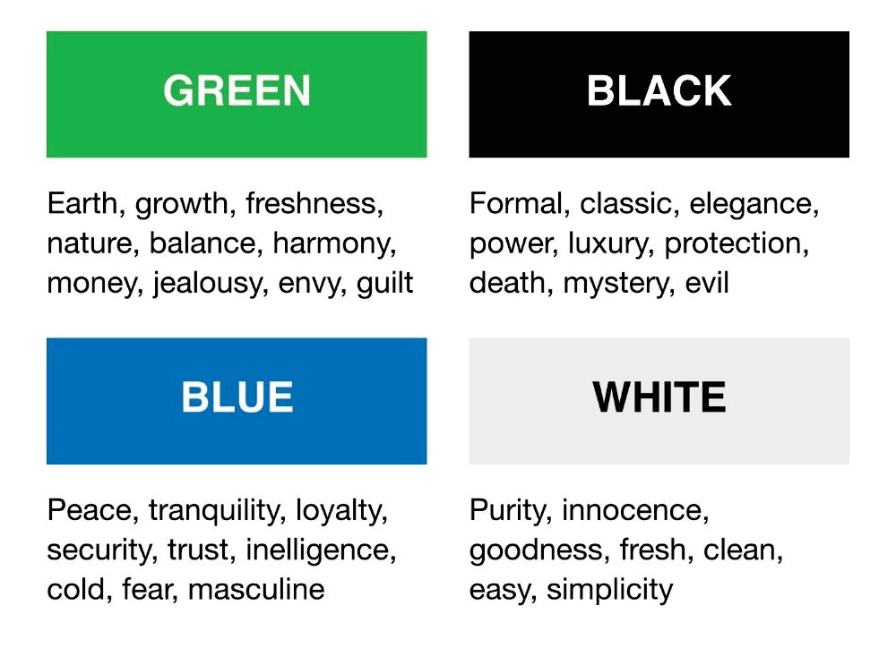
Colour and Meaning

Slide 17
